Slide 1
Grids
Module 02
Data Science Developer

Slide 2
Grids
Grids are general types of plots that allow you to map plot types to rows and columns of a grid, this helps you create similar plots separated by features.

Slide 3
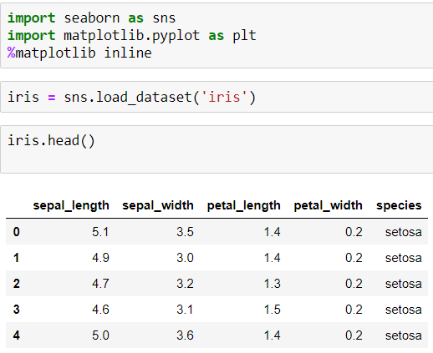
Imports and Data

Slide 4
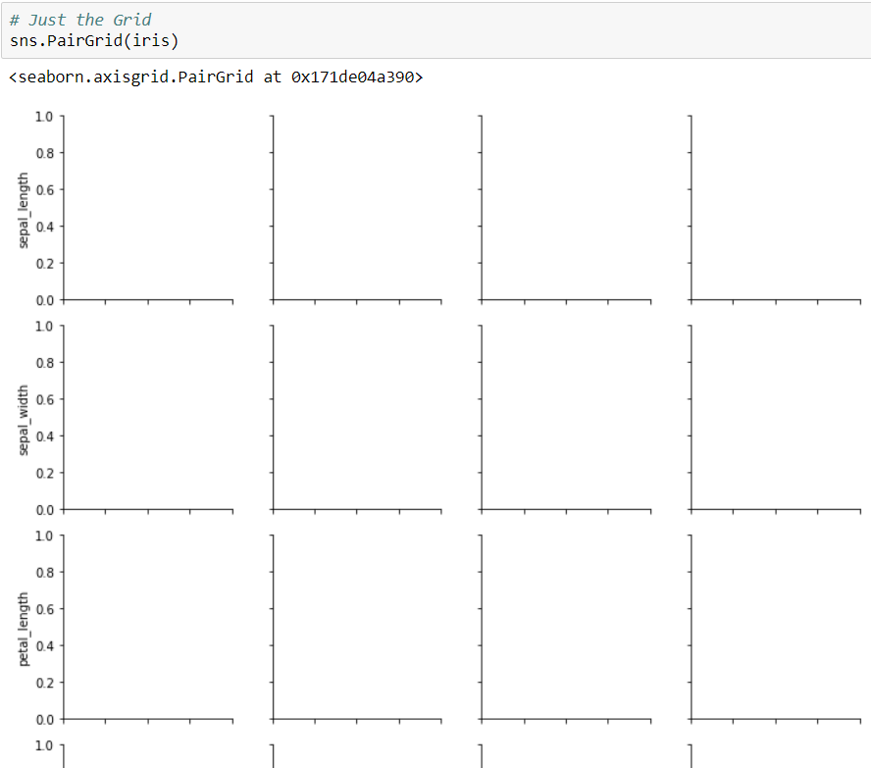
PairGrid
Pairgrid is a subplot grid for plotting pairwise relationships in a dataset.

Slide 5
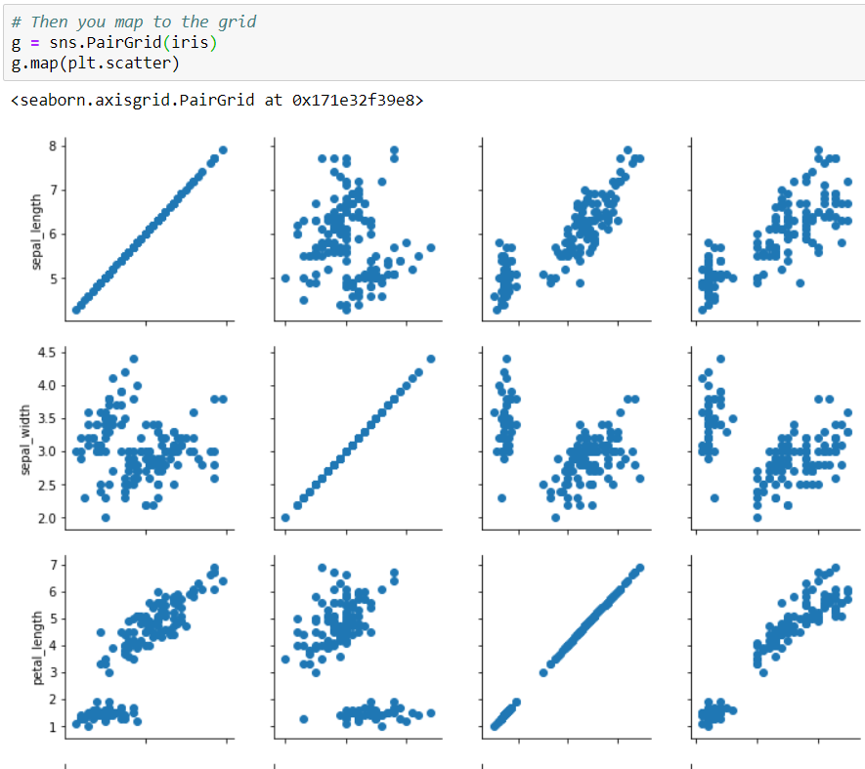

Slide 6
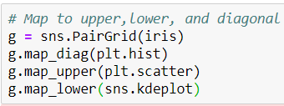
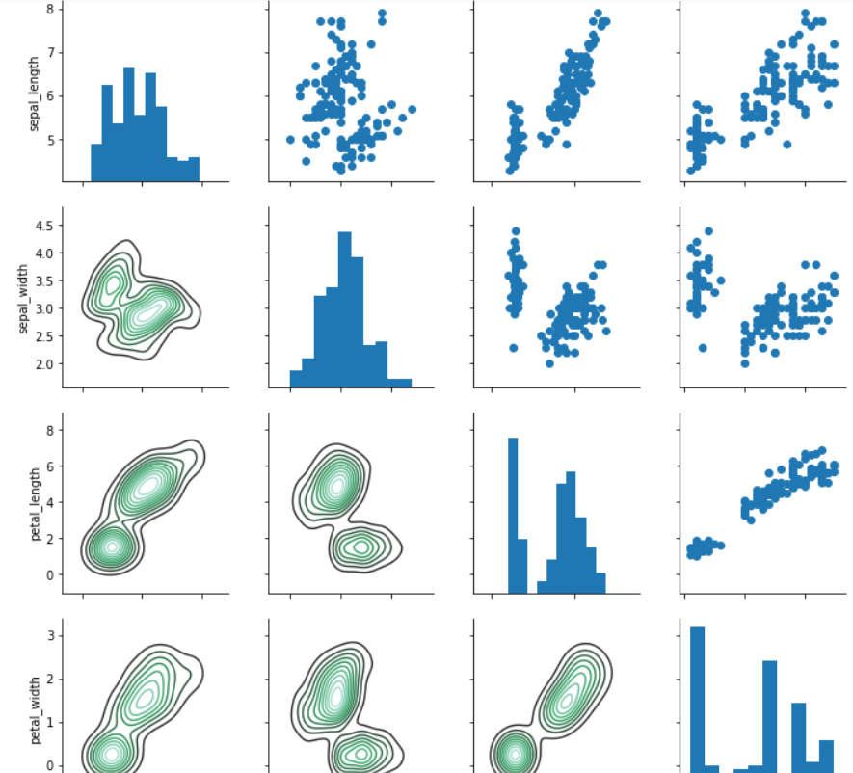

Slide 7

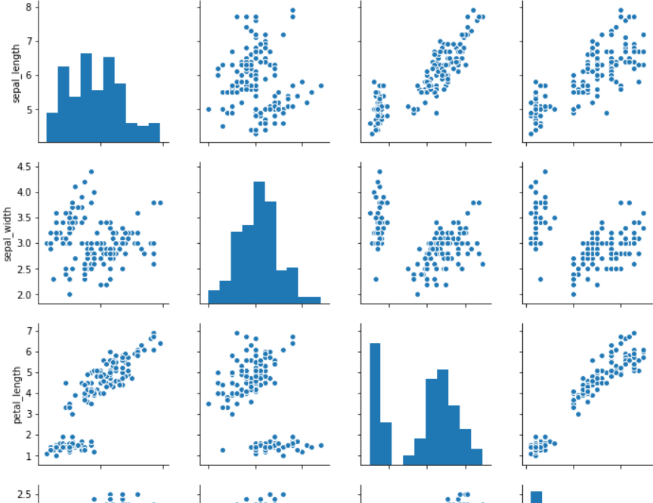
pairplot
pairplot is a simpler version of PairGrid (you'll use quite often)

Slide 8
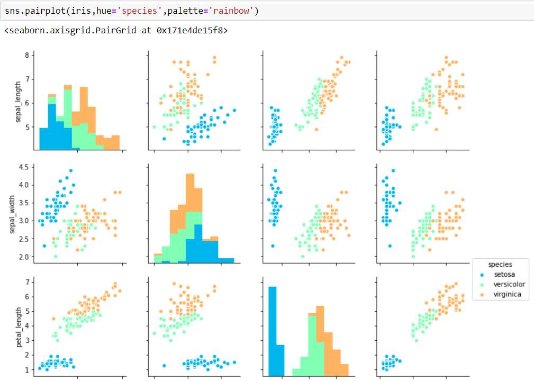

Slide 9
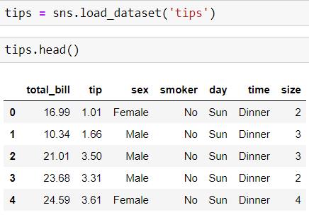
Facet Grid
FacetGrid is the general way to create grids of plots based off of a feature:

Slide 10
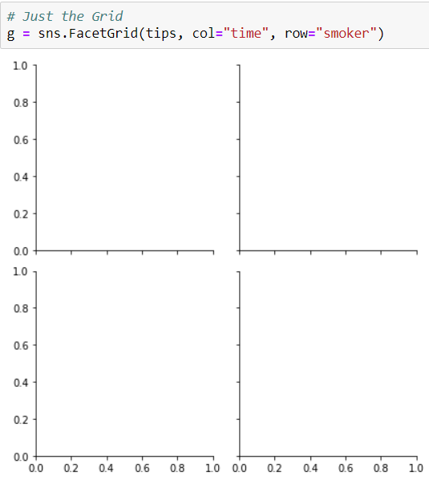

Slide 11
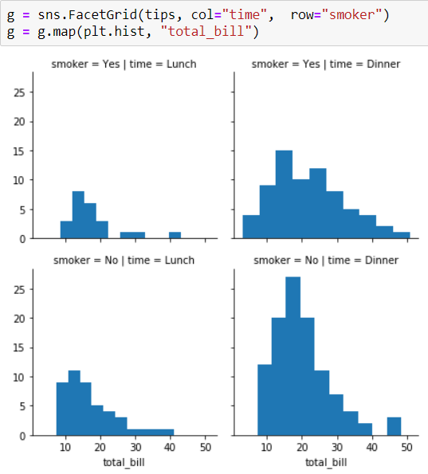

Slide 12
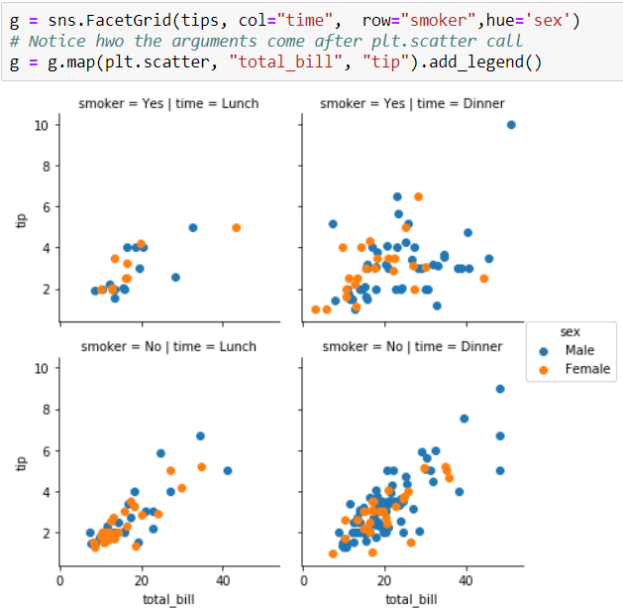

Slide 13
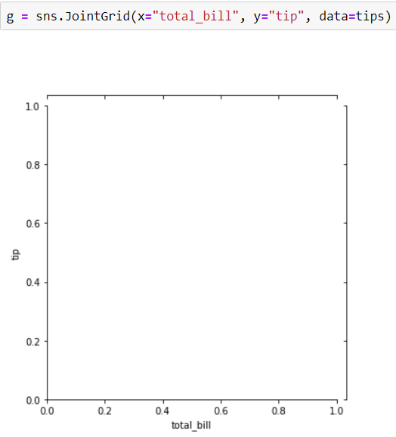
JointGrid
JointGrid is the general version for jointplot() type grids, for a quick example:

Slide 14

